Slide 1

Burnout in the Age of AI
2026 Tech Mental Health Analysis
A data-driven investigation into burnout, anxiety & attrition
across 100,000 tech workers worldwide
100K
36
10
2026
Employees
Variables
Countries
Dataset
Presented by: Aditya Bramhwanshi | UptoSkills Internship — Mega Data Presentation | May 2026

Slide 2



Project Overview
What we set out to solve — and why it matters
WHAT WE ANALYZED
STRATEGIC PURPOSE
Dataset: mental_health_burnout_tech_2026.csv
Records: 100,000 tech employees
Variables: 36 columns — demographics, work conditions, PHQ-9 & GAD-7 clinical scores
Countries: USA, India, UK, Germany, Canada, Australia + 4 more
Clinical Scales: PHQ-9 (Depression) & GAD-7 (Anxiety) — real medical scoring systems
Help HR leaders identify which roles need intervention first
Give C-Suite the financial case: burnout → attrition → cost
Support researchers with clinical-grade behavioral data
Expose the therapy access gap — resources aren't reaching people

Slide 3

The Business Problem
Asking the right questions before touching any data
Companies are hiring more, paying more & offering remote work — yet burnout is at an all-time high in 2026. Why?
1
Why are companies worried?
Burned-out employees quit — replacing one engineer costs 6–9 months salary
2
Why burn out despite good salaries?
Salary alone doesn't protect mental health — hours, sleep & manager support matter more
3
Why aren't employees seeking help?
55% with therapy access don't use it — the gap is culture, not resources
4
Why does that gap exist?
Stigma & fear of judgment make employees feel unsafe asking for help
5
Why act on THIS data specifically?
It pinpoints exactly which roles, work modes & countries have worst outcomes

Slide 4



Methodology & Tools
How we processed, analyzed and visualized the data
MySQL Workbench
Power BI Desktop
DAX Measures
Loaded 100K records into relational DB. Wrote 10+ SQL queries covering burnout by role, country, work mode, therapy gap & attrition risk.
Connected CSV directly. Built 5 core visuals + 5 KPI cards + 4 interactive slicers on a single-page dark-theme executive dashboard.
Created 6 custom measures: Burnout Rate %, Therapy Gap %, Avg Score, Job Change Intention % and 2 calculated columns.
CSV Dataset → MySQL Workbench → Power BI Dashboard → Insights & PPT

Slide 5
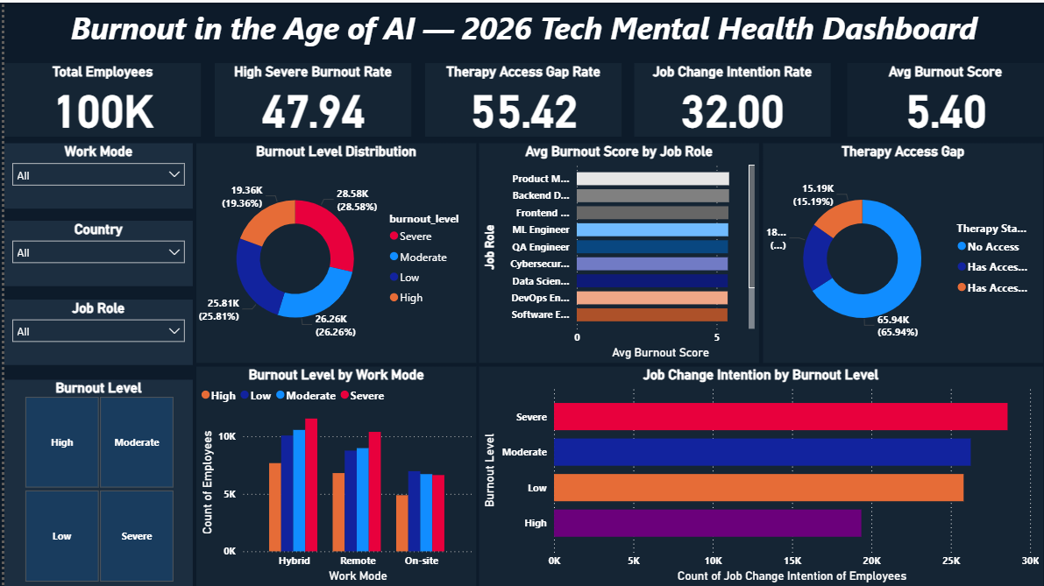
Power BI Dashboard
Single-page View 5 KPIs · 5 Charts · 4 Slicers
100K Records
Zero Nulls
2026 Data
KPI Insights
Interactive Slicers

Slide 6

Insight 1 — The Scale of the Crisis
Who is burning out and how severe is it?
47.9%
5.40
32%
High + Severe Burnout
Avg Burnout Score
Plan to Quit
Nearly 1 in 2 tech workers
Out of 10 — dangerously high
Job change intention rate
Key Takeaway
28,576 employees show SEVERE burnout — the highest clinical category. Combined with the HIGH group, nearly half the workforce is in crisis.
This is not a wellness trend. This is a workforce emergency.

Slide 7
Insight 2 — Who Is Most Affected?
Burnout by job role and work mode
💡 Insight
Remote workers score highest in burnout (5.48) — contradicting the belief that flexibility reduces stress.
Product Managers & Backend Developers lead by role — deadline pressure & autonomy gaps are key drivers.

Slide 8
Insight 3 — The Therapy Access Gap
Companies provide support. Employees aren't using it. Why?
65.9%
Have NO therapy access at all
55.4%
Of those WITH access still don't use it
15.2%
Actually receive & use therapy
The problem is not resources — it's reach. Culture & stigma are the real barriers.

Slide 9
Insight 4 — Burnout Is a Business Problem
High burnout directly drives attrition intention
32,000
Employees plan to quit this year
6–9x
Monthly salary cost to replace one engineer
$2.7B+
Estimated industry attrition cost (projected)

Slide 10



Recommendations to Stakeholders
Three targeted interventions — data-backed
For HR Leaders
For C-Suite
For Leadership
Close the Therapy Utilization Gap
Rethink the Remote Work Model
Build a Burnout Early Warning System
55% of employees with access don't use it. Launch anonymous, manager-bypassed mental health check-ins. Normalize therapy like sick leave. Target Product Managers & Backend Developers first.
Remote employees show the highest burnout (5.48 avg). Implement structured async policies, camera-off norms & reduce meeting load for distributed teams. Flexibility without boundaries backfires.
Flag employees scoring 7+ on stress + burnout + poor sleep as 'Critical Risk'. Proactive outreach beats reactive HR. Identify at-risk employees before they become attrition statistics.

Slide 11


Conclusion
"The data doesn't just tell us there's a problem — it tells us exactly where to intervene first."
47.9% of 100K tech workers show High or Severe burnout in 2026
Remote workers are the most burned out — flexibility alone ≠ wellbeing
55% with therapy access don't use it — a culture problem, not a resource problem
32,000 employees plan to quit — burnout is the #1 attrition driver
Dataset: mental_health_burnout_tech_2026.csv | Tools: MySQL Workbench · Power BI · DAX | UptoSkills Internship — Final Presentation | May 2026

Slide 12
Thankyou

